Slide 1
Bernoulli Naive Bayes Classifier
Bernoulli Naive Bayes is a subcategory of the Naive Bayes Algorithm.
It is typically used when the data is binary and it models the occurrence of features using Bernoulli distribution.
It is used for the classification of binary features such as 'Yes' or 'No', '1' or '0', 'True' or 'False' etc.

Slide 2
In Bernoulli Naive Bayes model we assume that each feature is conditionally independent given the class y.
Bernoulli NB considers both presence AND absence of features.

Slide 3
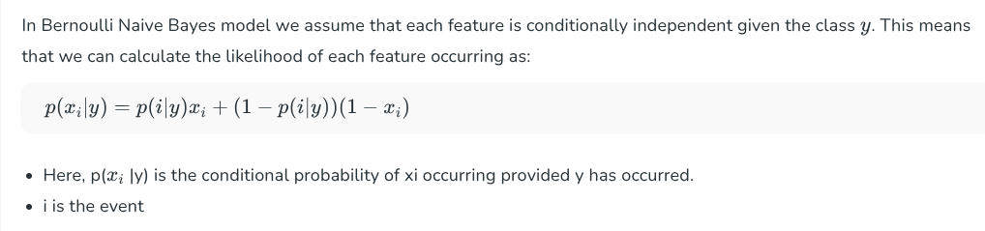

Slide 4
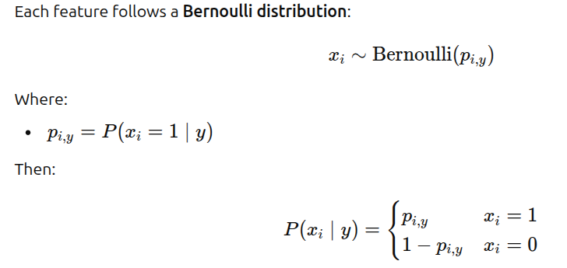
Contd….

Slide 5
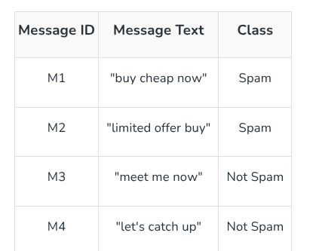
Example -Dataset

Slide 6
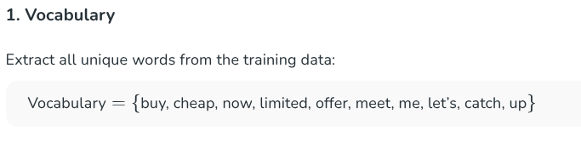
Test message: “buy now”

Slide 7
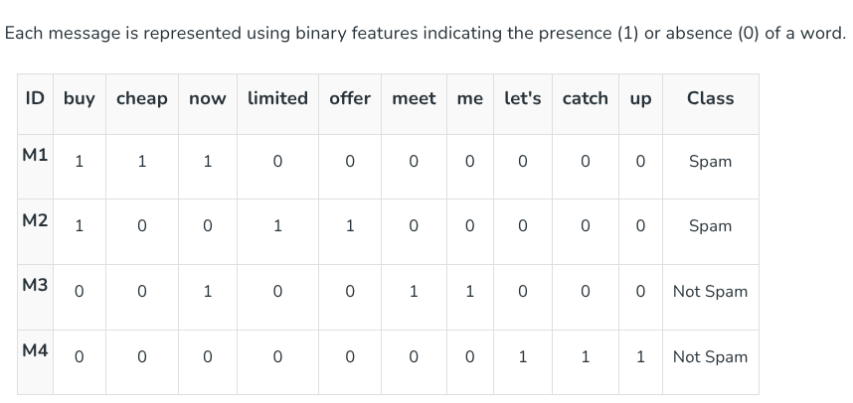

Slide 8
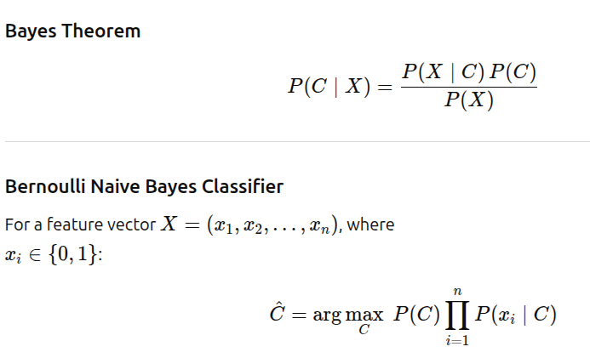

Slide 9
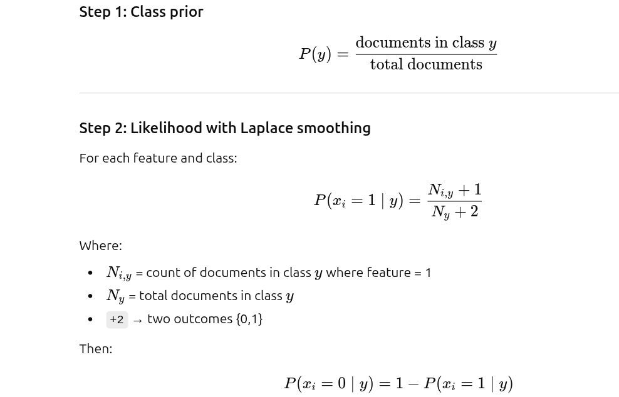
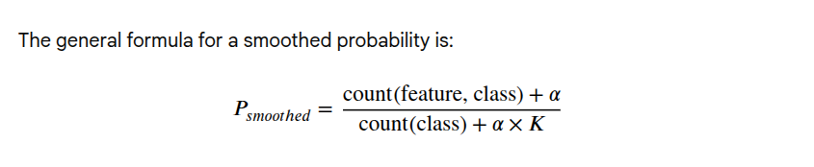
The above general formula is applied with likelihood, smoothening parameter α=1. K is the possible outcomes(values) of the features.

Slide 10
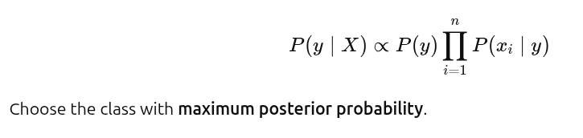

Slide 11
Priors
P(Spam)=0.5
P(Not Spam)=0.5

Slide 12
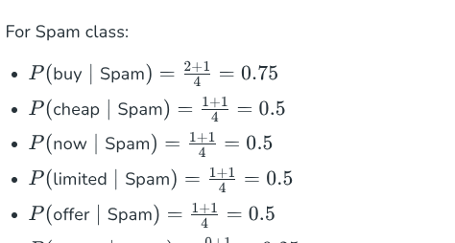

Slide 13
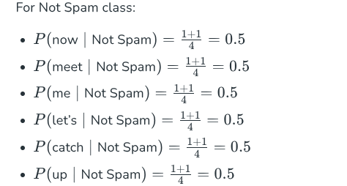

Slide 14
Likelihood: buy
Class =Spam
[ P(buy=1|Spam) = (2+1)/(2+2) = 3/4 ]
[ P(buy=0|Spam) = 1 - 3/4 = 1/4 ]
class=Not Spam
[ P(buy=1|NotSpam) = (0+1)/(2+2) = 1/4 ][ P(buy=0|NotSpam) = 1 - 1/4 = 3/4 ]

Slide 15
Likelihood: now
Class= Spam
[ P(now=1|Spam) = (1+1)/(2+2) = 1/2 ]
[ P(now=0|Spam) = 1/2 ]
class=Not Spam
[ P(now=1|NotSpam) = (1+1)/(2+2) = 1/2 ]
[ P(now=0|NotSpam) = 1/2 ]

Slide 16
Posterior Probability – Spam
P(Spam∣X)=P(Spam)⋅P(buy=1∣Spam)⋅P(now=1∣Spam)=0.5⋅0.75⋅0.5=0.1875
Posterior Probability -Not Spam
P(Not Spam∣X)=P(Not Spam)⋅P(buy=1∣Not Spam)⋅P(now=1∣Not Spam)
=0.5⋅0.25⋅0.5=0.0625

Slide 17
Final Classification
P(Spam∣X)=0.1875
P(Not Spam∣X)=0.0625
Since P(Spam∣X)>P(Not Spam∣X),
The message is classified as: Spam

Slide 18
Advantages
Fast training and prediction
Works well with binary values
Suitable for text classification (presence / absence)
Performs well even with small datasets

Slide 19
Limitations
Assumes features are independent
Works only with binary features
Needs smoothing to avoid zero probability
Not suitable for continuous numerical data

